Slide 1
An Update on the
Occupational Requirements Survey
A presentation for the
National Disability Forum
August 1, 2017

Slide 2

Bureau of Labor Statistics
Mission
  Collect, analyze, and disseminate economic information
  Support public and private decision-making
Provide products and services that are:
    Accurate
    Objective
    Relevant
    Timely
    Accessible

Slide 3
Bureau of Labor Statistics
Responsible for measuring
  Labor market activity
  Working conditions
  Price changes
  Compensation
  More…

Slide 4

National Compensation Survey
A voluntary, national
establishment survey with
11,000 units
Data are collected by
professional Field Economists via personal contact
Collects data on wages and benefits to produce various products, including the Employment Cost Index

Slide 5
The National Compensation Survey (NCS)
A voluntary, national survey of businesses and State and local governments
Professional staff make personal contacts
Wages and benefits
The Standard Occupational Classification (SOC) system guides job selection
All occupations are leveled using a point-factor method to determine a work-level based on related duties and responsibilities:
  Knowledge required, job controls and complexity, contacts, and physical environment

Slide 6
Occupational Requirements Survey
How was ORS developed?
  Proof concept
  Testing
  Survey design
  Dry-run
  Implementation

Slide 7
Occupational Requirements Survey
The Occupational Requirements Survey (ORS) will provide occupational-related data for:
Physical demands
Mental and cognitive demands
Environmental conditions
Vocational preparation

Slide 8

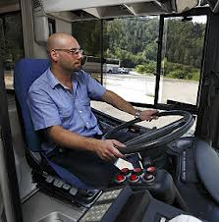
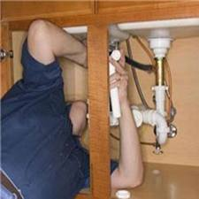

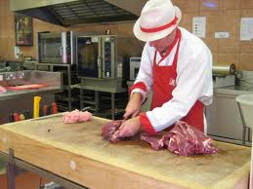
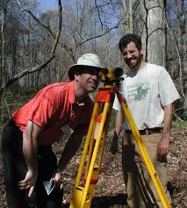





What is ORS?
Leg/ Foot Control
Pulling
Reaching
Measuring Physical Demands
Arm/ Hand Control
Keyboarding
Vision
Lifting
Climbing
Standing

Slide 9
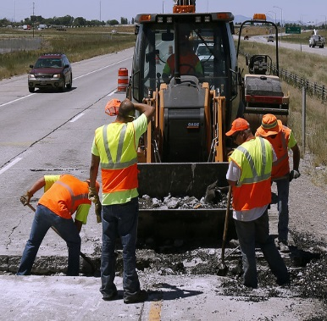
What is ORS?
Cold/ Heat
Fumes
Gases
Measuring Environmental Conditions
Working Outdoors
Moving Parts
Wetness/ Humidity
High Exposed Places
Dust
Chemicals

Slide 10

What is ORS?
Other Certification
Other Certification
Doctorate Degree
Measuring Vocational Preparation
Associate’s Degree
Other Certification
Master’s Degree
High School
Bachelor’s Degree
Professional Degree

Slide 11
Notes:
Although these components are collected to ultimately calculate SVP we also try to publish data related to these components when possible. For example, see …
Which leads me to our next element…

Slide 12
Proposed cognitive elements
Control of work pace
Work flow
Pause control
Work review
Problem solving
Personal contacts
More

Slide 13
More about ORS
Survey management structure
Local, professionally trained field economists make contact with pre-selected establishments
Company officials are interviewed via a personal visit or telephone
Several layers of quality review from the point of data collection through processing and aggregation of estimates
Year-long sample design (summer to summer)

Slide 14
ORS’ first wave
The first wave consists of 3 years (sample years) of collection
First production sample published December 2016
Second production sample being collected
Next ORS publication: November 2017
First year sample smaller than subsequent (6,500 establishments)
Following sample years will contain approximately 10,000 nationwide
Complete set of estimates expected early 2019

Slide 15
Additional testing
Job observation test
Cognitive elements test
Future: Incumbent test

Slide 16
Next steps
First five year wave with collection starting in September 2018
Introduce revised cognitive elements
Potential new sample design
  Many more estimates than current design
  National estimates not available until fifth year

Slide 17
ORS estimates
Data from the first full sample available December 2016:
  News release
  Data to be made accessible through a BLS website query tool
  Full data extract
All estimates are available at:
  www.bls.gov/ORS
  (202) 691-6199

Slide 18
Hilery Simpson
Assistant Commissioner
(202) 691-5184
Simpson.Hilery@bls.gov
Questions about the ORS estimates?
(202) 691-6199 www.bls.gov/ors

Slide 19
Contact Information
Hilery Simpson
Assistant Commissioner
(202) 691-5184
Simpson.Hilery@bls.gov
Questions about the ORS estimates?
(202) 691-6199
www.bls.gov/ors

